Slide 1
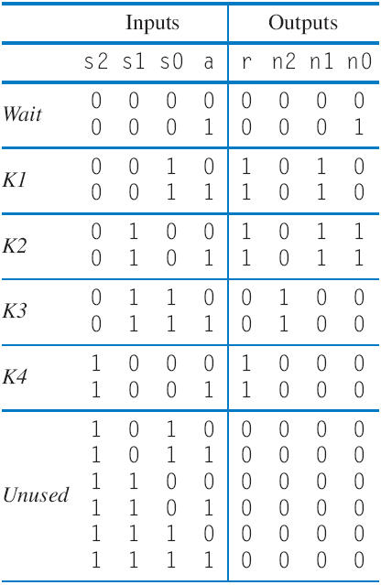
Controller Example: Secure Car Key
(from earlier example)
Inputs: a; Outputs: r
Wait
r=0
a
a
’
Step 1
K1
K2
K3
K4
a
r=1
r=1
r=0
r=1
a
r
Step 2A
Combinational
logic
n2
n1
n0
s2
s1
s0
clk
State register
nputs:
I
a
;
O
utputs:
r
000
r=0
a
’
a
Step 2B
001
010
011
100
r=1
r=1
r=0
r=1
Step 2C
We’ll omit Step 2D

